Slide 1
Introduction to MVC
Ivan Yonkov
Training Manager
Software University
www.softuni.bg

Slide 2
PHPMVC

Slide 3
Web App Structure
Notes:
Typically Web Applications have structure that follows the architectural model(s) used in the application.

Slide 4
Web App Structure
Web Browser
Presentation
Presentation Logic
Business Logic
Data Access Logic
Database
Notes:
This is the usually scenario, not the necessary one. Anyway, in most of the cases an end user hits our page by opening the web browser and an HTML (presentation) is there.
Optionally this HTML is controlled by conditional statements and loops – called presentation logic.
In order the presentation logic to work, there’s a layer that checks whether the user can access this page, in which format they should receive the response, how the data should get through the layers and so forth. It’s called Business Logic. The Business Logic eventually contacts a Data Access Layer – this layer that knows how to access data. Usually it access data from a Database, so it contacts the last layer in the chain – the Database.

Slide 5
PHP App Structure
Web Browser
Views: HTML + PHP
PHP Controller Classes
PHP Model Classes
PHP Data Access Classes
MySQL
Notes:
In typical PHP MVC Structure, the web browser sees our product – views, which are usually .php files that contains HTML and a little bit PHP to control the HTML Rendering.
These .php files receives data through PHP Controller classes. These classes does invoke the Views and send them data as some kind of arguments.
But in order the controller classes to receive data, they contact the model classes. They actually have the data and map it in a way the business scenario needed. Or maybe they don’t give be because of lack of privileges. The model layer is responsible for the business logic over the data.
Models are populated by contacting the PHP Data Access classes that might contact the MySQL DB through the PDO for instance.

Slide 6
Data Processing

Slide 7
Data Access
Database Access Logic
ORM Approach
Direct Access
Map Tables to Classes
Data Access Classes
Notes:
ORM Approach:
$user = $userRepo->findById(4);
$user->setName(“Johnathan”);
$userRepo->save($user);
Direct Access:
$db->query(“UPDATE users SET name = “Johnathan” WHERE id = 4”);

Slide 8
Data Binding
Data Binding
Form Data
View Data
Map Form Data to Objects
Map Variables to ViewModels
Notes:
Form data:
Instead:
public function edit() {
$id = $_GET[‘id’];
$name = $_POST[‘name’];
// do smth
}
do:
public function edit($id, UserBindingModel $user) {
$name = $user->getName();
// do smth
}
View data:
Instead:
public function index() {
$this->view->name = “John”;
$this->view->age = 24;
}
do:
public function index() {
$userViewModel = new UserViewModel(“John”, 24);
return view($userViewModel);
}

Slide 9
Front Controller

Slide 10

Front Controller
Controller
View
HTTP Request
Front Controller
Controller
View
Controller
View
10
Notes:
What is "front controller"?
Architectural design pattern for Web applications
Front controller == centralized entry point for all requests

Slide 11
Enough Theory!!!

Slide 12
URL Rewrite
.htaccess
<IfModule mod_rewrite.c>
RewriteEngine On
RewriteCond %{REQUEST_URI} !^/content/.*$
RewriteCond %{REQUEST_URI} !^/favicon\.ico$
RewriteRule ^ index.php
</IfModule>
Notes:
In order this to work you first need to enable the mod_rewrite extension in your Apache webserver

Slide 13
URL Rewrite (2)
$uri = $_SERVER['REQUEST_URI']; var_dump($uri);

Slide 14
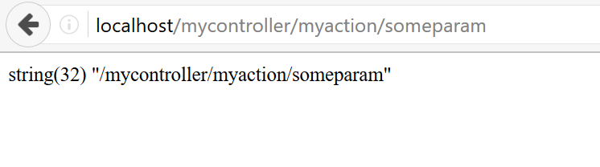
URL Rewrite (3)

Slide 15
URL Rewrite (4)
$uri = $_SERVER['REQUEST_URI']; $self = explode("/", $_SERVER['PHP_SELF']); array_pop($self); $replace = implode("/", $self); $uri = str_replace($replace."/", "", $uri);
Replace Nested Folders
Notes:
Our app may reside in nested folders structure e.g. /www/myapp/core/index.php
It could be accessed through localhost:/myapp/core/ - we need to remove /myapp/core/ from the URI

Slide 16
URL Rewrite (5)
$params = explode("/", $uri); $controllerName = array_shift($params); $actionName = array_shift($params); var_dump($controllerName); var_dump($actionName); var_dump($params);
Notes:
Our app may reside in nested folders structure e.g. /www/myapp/core/index.php
It could be accessed through localhost:/myapp/core/ - we need to remove /myapp/core/ from the URI

Slide 17
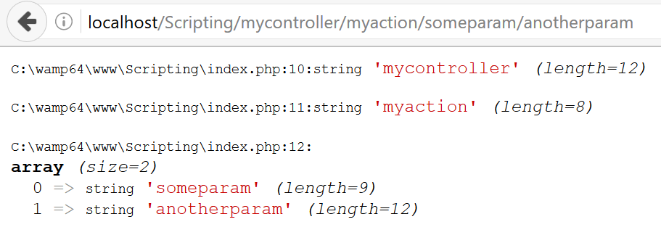
URL Rewrite (6)

Slide 18
Dispatching

Slide 19
Dispatching
Print “Hello World” when /hello/world is accessed. Print “Hello Software University” when /hello/softuni is accessed.

Slide 20
Dispatching (2)
if ($controllerName == "hello") { switch ($actionName): case "world": echo "Hello World"; break; case "softuni"; echo "Hello Software University"; break; endswitch; }

Slide 21
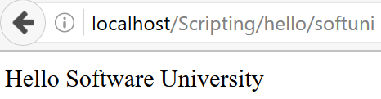
Dispatching (3)

Slide 22
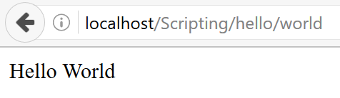
Dispatching (4)

